Slide 1
Predefined Attributes
Chapter8

Slide 2
Value Type Attributes
Attributes.
Types and objects declared in a VHDL description can have additional information, called attributes, associated with them.
An attribute is referenced using the ‘'’ notation. For example,
thing'attr.
refers to the attribute attr of the type or object thing.
Firstly, for any scalar type or subtype T, the following attributes can be used:
Attribute Result.
T'left Left bound of T.
T'right Right bound of T.
T'low Lower bound of T.
T'high Upper bound of T.

Slide 3
Value Type Attr. (Cont.)
Secondly, for any discrete or physical type or subtype T, X a member of T, and N an integer, the following attributes can be used:
Attribute Result.
T'pos(X) Position number of X in T.
T'val(N) Value at position N in T.
T'leftof(X) Value in T which is one position left from X.
T'rightof(X) Value in T which is one position right from X.
T'pred(X) Value in T which is one position lower than X.
T'succ(X) Value in T which is one position higher than X.
For an ascending range, T'leftof(X) = T'pred(X), and T'rightof(X) = T'succ(X). For a descending range, T'leftof(X) = T'succ(X), and T'rightof(X) = T'pred(X).

Slide 4
Value Type Attr. (Cont.)
Thirdly, for any array type or object A, and N an integer between 1 and the number of dimensions of A, the following attributes can be used:
Attribute Result
A'left(N) Left bound of index range of dim’n N of A
A'right(N) Right bound of index range of dim’n N of A
A'low(N) Lower bound of index range of dim’n N of A
A'high(N) Upper bound of index range of dim’n N of A
A'range(N) Index range of dim’n N of A
A'reverse_range(N) Reverse of index range of dim’n N of A
A'length(N) Length of index range of dim’n N of A

Slide 5
Value Type Attr. (Cont.)
Example:
type logic_level is (unknown, low, undriven, high);
logic_level’pos(unknown) = 0
logic_level’val(3) = high
logic_level’succ(unknown) = low
logic_level’pred(undriven) = low
type set_index is range 21 downto 11
set_index’left = 21
set_index’ascending = false

Slide 6
Value Array Attributes
There only one value array attribute
‘LENGTH
Example : -
PROCESS (a)
TYPE bit4 IS ARRAY (0 to 3) of BIT;
TYPE bit_strange IS ARRAY (10 TO 20) OF BIT;
VARIABLE len1, len2 : INTEGER;
BEGIN
len1 := bit4’LENGTH; -- return 4
len2 := bit_strange’LENGTH; -- return 11
END PROCESS;

Slide 7
Function Signal Attributes
S’EVENT
which returns true if an event occurred during the current delta; otherwise, returns false.
S’ACTIVE
which returns true if a transaction occurred during the current delta; otherwise, returns false.
S’LAST_EVENT
which returns time elapsed since the previous event transition of signal.
S’LAST_VALUE
which returns previous value of S before the last event.
S’LAST_ACTIVE
which returns time elapsed since the previous transaction of signal.

Slide 8
Attribute ‘EVENT and ‘LAST_VALUE
Attribute ‘EVENT is used to determine clock edges by detected the changes of the clock signal.
Here is an example of rising edge detector:
LIBRARY IEEE;
USE IEEE.std_logic_1164.ALL;
ENTITY dff IS
PORT( d, clk : IN std_logic; q : OUT std_logic);
END dff;
ARCHITECTURE dff OF dff IS
BEGIN
PROCESS(clk)
BEGIN
IF ( clk = ’1’) AND ( clk’EVENT ) and ( clk’LAST_VALUE=‘0’ ) THEN
q <= d;
END IF;
END PROCESS;
END dff;

Slide 9
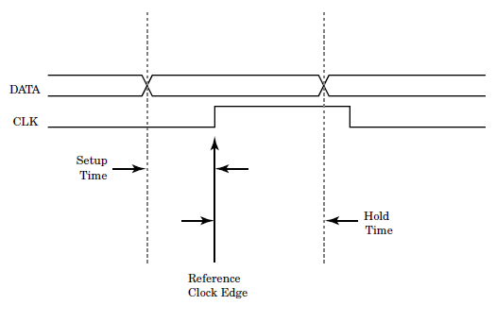
Attribute ‘LAST_EVENT
Attribute ‘LAST_EVENT returns the time since the previous event occurred on the signal.
This attribute useful for implementing timing check such as setup checks, hold checks and pulse width checks.

Slide 10
Attribute ‘LAST_EVENT (Cont.)
The rising edge of signal clk is the reference edge to which all checks are performed. A setup time check guarantees that the data input does not change during the setup time.

Slide 11
Attribute ‘ACTIVE and ‘LAST_ACTIVE
Attribute ‘ACTIVE and ‘LAST_ACTIVE trigger on transaction of the signal attached to AND events.
Attribute ‘ACTIVE returns true when a transaction or event occurs on a signal.
Attribute ‘LAST_ACTIVE returns the time since a previous transaction or event occurred on the signal it is attached to.

Slide 12
Signal Kind Attributes
S’DELAYED
[(time)], which creates a signal of the same type as the reference signal that follows the reference signal, delayed by the time of the optional time expression
S’STABLE
[(time)], which creates a boolean signal that is true whenever the reference signal has had no events for the time specified by the optional time expression
S’QUIET
[(time)], which creates a boolean signal that is true whenever the reference signal has had no transactions or events for the time specified by the optional time expression
S’TRANSACTION
which creates a signal of type BIT that toggles its value for every transaction or event that occurs on s

